Slide 1

Data Analytics
By Marvellous Isijola

Slide 2
What is Data Analytics?
Data analytics to begin with is the inspecting and studying of data to find patterns and therefore make more educated decisions. For example, this would help a restaurant know which of their menu items sell more and buy ingredients according to what sells in order not to lose money.

Slide 3
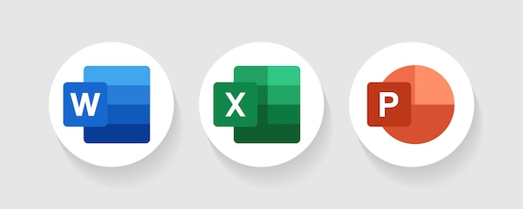



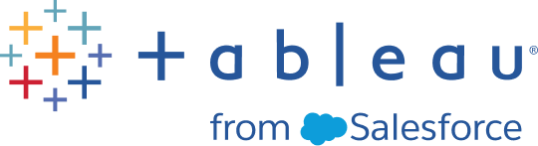
Data Analytics tools
To analyze data you would need to tools to manage it, like Excel to sort the data and applications like Access to store databases. You would also need tools to show data like Word and PowerPoint.
But aside these there are applications created with data analytics specifically in mind like Google Cloud, Tableau and Microsoft Azure.

Slide 4
Why Data Analytics?
Data Analytics is a huge industry and is very useful in companies so there are many jobs related to data analytics open. It is also quite high paying as the ability to handle data is a very valuable skill to have. It also leads to better decision making, retention and loyalty, and increase in the efficiency of work.

Slide 5
How does it compare to another popular branch of tech?
Data Analytics
Game development
Data Analytics has a positive impact on the brain.
It can be used in multiple other industries including game dev.
Jobs using this skill are almost always available and high paying.
Game development utilizes your creativity.
It works on your resilience as sometimes you are faced with errors, bugs and glitches in development.
Games are constantly being made and played and is a thriving industry.

Slide 6


